Slide 1
TECH FOR THE VISUALLY IMPAIRED
TOUCH TO SIGHT

Slide 2


Slide 3


Slide 4
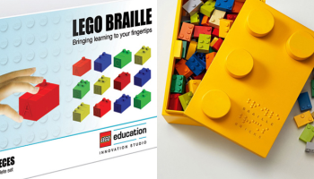

Slide 5

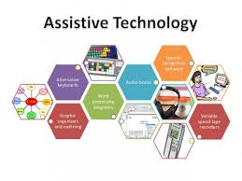

Slide 6



Slide 7
Inability is not disability

